Slide 1
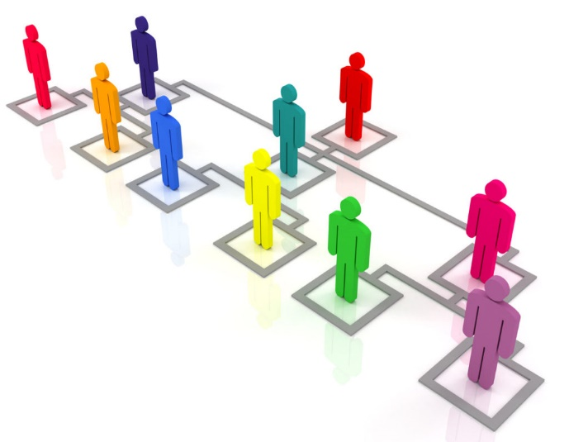
IS204
System Analysis and Design
System Development
Organizational and Business Context
COMPUTER INFORMATION SYSTEM DEPARTMENT ASS.LEC. ZAINAB H. ALFAYEZ

Slide 2
Systems That Solve Business Problems
System: interrelated components functioning together to achieve an outcome.
Information systems: collection of interrelated components that collect, process, store, and provide as output information needed to complete tasks.
Subsystem: part of a larger system.
Functional decomposition: dividing a system into smaller subsystems and components.
COMPUTER INFORMATION SYSTEM DEPARTMENT ASS.LEC. ZAINAB H. ALFAYEZ

Slide 3
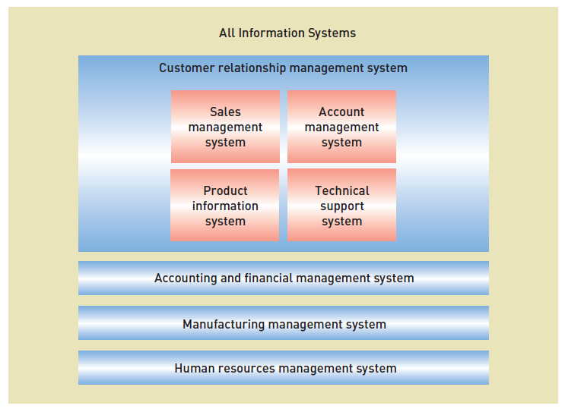
Information Systems and Subsystems
COMPUTER INFORMATION SYSTEM DEPARTMENT ASS.LEC. ZAINAB H. ALFAYEZ

Slide 4
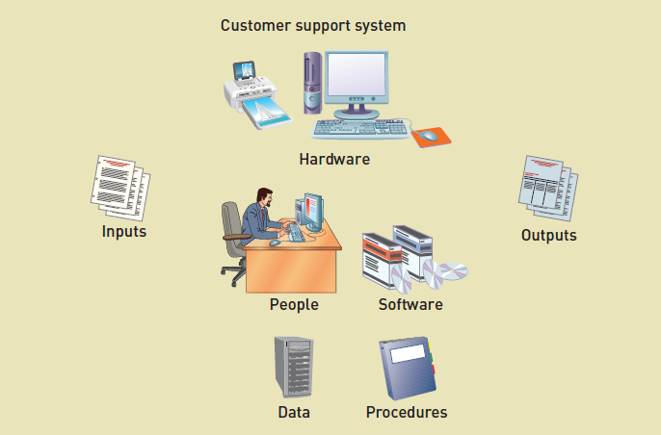
Information Systems and Components
COMPUTER INFORMATION SYSTEM DEPARTMENT ASS.LEC. ZAINAB H. ALFAYEZ

Slide 5
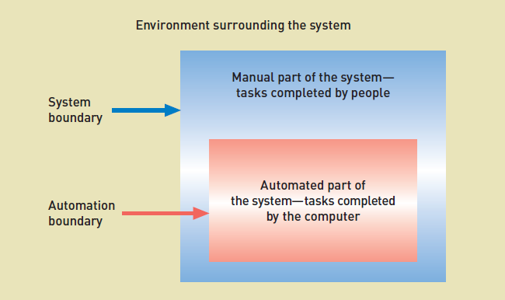
System Boundary vs. Automation Boundary
COMPUTER INFORMATION SYSTEM DEPARTMENT ASS.LEC. ZAINAB H. ALFAYEZ

Slide 6
Types of Information Systems
Customer relationship management (CRM) system: a system that supports marketing, sales, and service operations involving direct and indirect customer interaction.
Supply chain management (SCM) system: a system that seamlessly integrates product development, product acquisition, manufacturing, and inventory management.
Accounting and financial management (AFM) system: a system that records accounting information needed to produce financial statements and other reports used by investors and creditors.
Human resource management (HRM) system: a system that supports such employee-related tasks as payroll, benefits, hiring, and training.
COMPUTER INFORMATION SYSTEM DEPARTMENT ASS.LEC. ZAINAB H. ALFAYEZ

Slide 7
Types of Information Systems
Manufacturing management system: a system that controls internal production processes that turn raw materials into finished goods.
Knowledge management system (KMS): a system that supports the storage of and access to documents from all parts of the organization.
Collaboration support system (CSS): a system that enables geographically distributed personnel to collaborate on projects and tasks.
Business intelligence system: a system that supports strategic planning and executive decision making.
Enterprise resource planning (ERP): a process in which an organization commits to using an integrated set of software packages for key information systems
COMPUTER INFORMATION SYSTEM DEPARTMENT ASS.LEC. ZAINAB H. ALFAYEZ

Slide 8
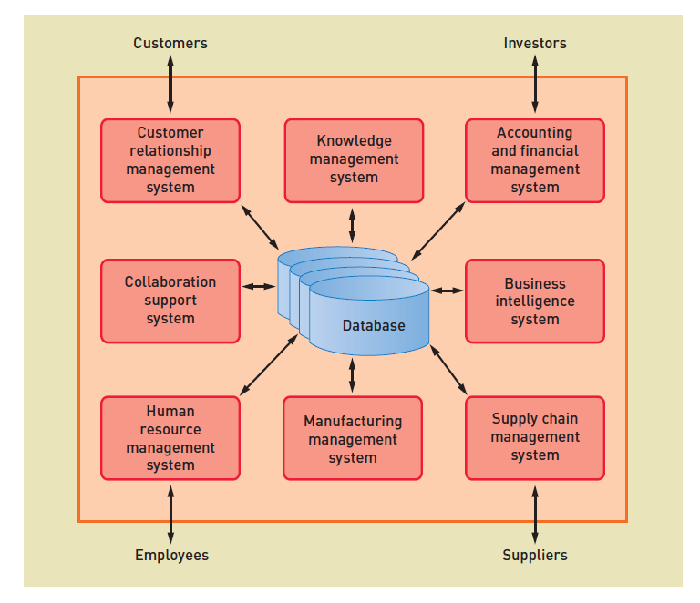
Types of Information Systems
Database?

